Slide 1

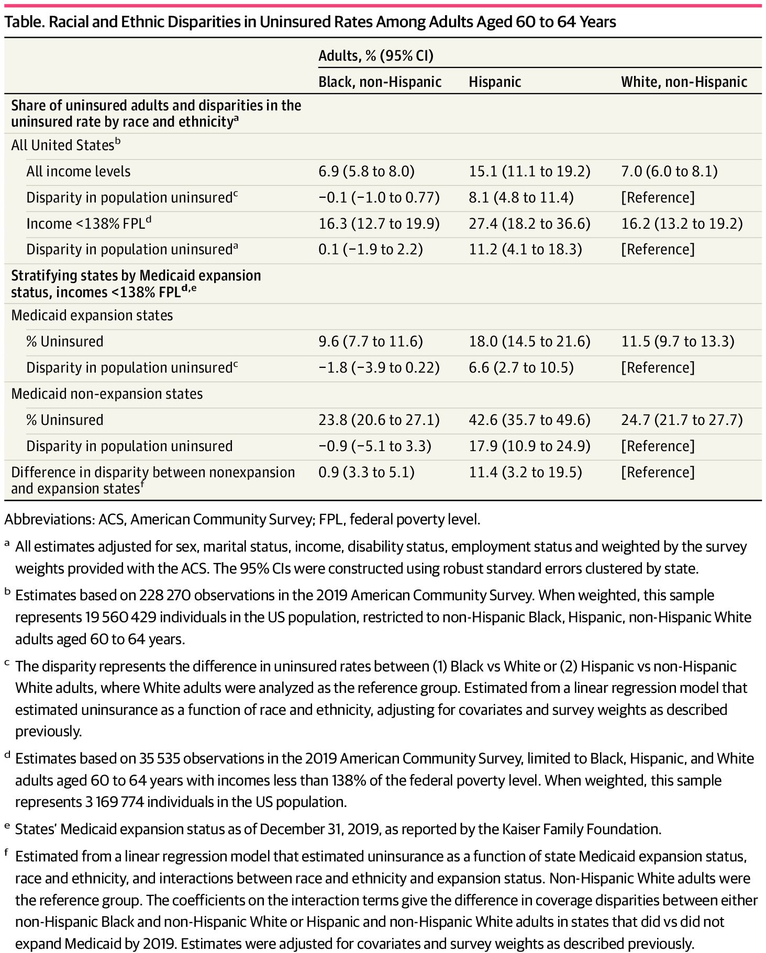
From: Racial and Ethnic Disparities in Insurance Coverage Among US Adults Aged 60 to 64 Years
JAMA Netw Open. 2022;5(4):e229406. doi:10.1001/jamanetworkopen.2022.9406
^{Table Title:}
Racial and Ethnic Disparities in Uninsured Rates Among Adults Aged 60 to 64 YearsAbbreviations: ACS, American Community Survey; FPL, federal poverty level.
a All estimates adjusted for sex, marital status, income, disability status, employment status and weighted by the survey weights provided with the ACS. The 95% CIs were constructed using robust standard errors clustered by state.
b Estimates based on 228 270 observations in the 2019 American Community Survey. When weighted, this sample represents 19 560 429 individuals in the US population, restricted to non-Hispanic Black, Hispanic, non-Hispanic White adults aged 60 to 64 years.
c The disparity represents the difference in uninsured rates between (1) Black vs White or (2) Hispanic vs non-Hispanic White adults, where White adults were analyzed as the reference group. Estimated from a linear regression model that estimated uninsurance as a function of race and ethnicity, adjusting for covariates and survey weights as described previously.
d Estimates based on 35 535 observations in the 2019 American Community Survey, limited to Black, Hispanic, and White adults aged 60 to 64 years with incomes less than 138% of the federal poverty level. When weighted, this sample represents 3 169 774 individuals in the US population.
e States’ Medicaid expansion status as of December 31, 2019, as reported by the Kaiser Family Foundation.
f Estimated from a linear regression model that estimated uninsurance as a function of state Medicaid expansion status, race and ethnicity, and interactions between race and ethnicity and expansion status. Non-Hispanic White adults were the reference group. The coefficients on the interaction terms give the difference in coverage disparities between either non-Hispanic Black and non-Hispanic White or Hispanic and non-Hispanic White adults in states that did vs did not expand Medicaid by 2019. Estimates were adjusted for covariates and survey weights as described previously.
^{Date of download: 7/26/2025}

